Slide 1
CIS 9660 – Data Mining for Analytics
Week 5 Decision Trees and Logistic Regression
Prof. Arturo Castellanos
CIS Department Office: VC11-229

Slide 2
Machine Learning: Supervised vs. Unsupervised Learning
Supervised Learning (Estimation and Classification)
The training data contains target class information for each record (e.g. spam, churn).
New records are classified based on the models developed on the training data (e.g. scoring).

Slide 3

Supervised Learning
Classification
Assign items to a discrete class based on training data. Think of target variables (e.g. binary: donor/non-donor; will survive/will die;
Regression
Estimate a numerical value based on a set of features (e.g. predict house value).
Did Mr. Partner Survive?

Slide 4
General Approach for Building Classification Model

Slide 5
Data Dictionary
Variable | Definition | Key
survival | Survival | 0 = No, 1 = Yes
pclass | Ticket class | 1 = 1st, 2 = 2nd, 3 = 3rd
sex | Sex
Age | Age in years
sibsp | # of siblings / spouses aboard the Titanic
parch | # of parents / children aboard the Titanic
ticket | Ticket number
fare | Passenger fare
cabin | Cabin number
embarked | Port of Embarkation | C = Cherbourg, Q = Queenstown, S = Southampton

Slide 6
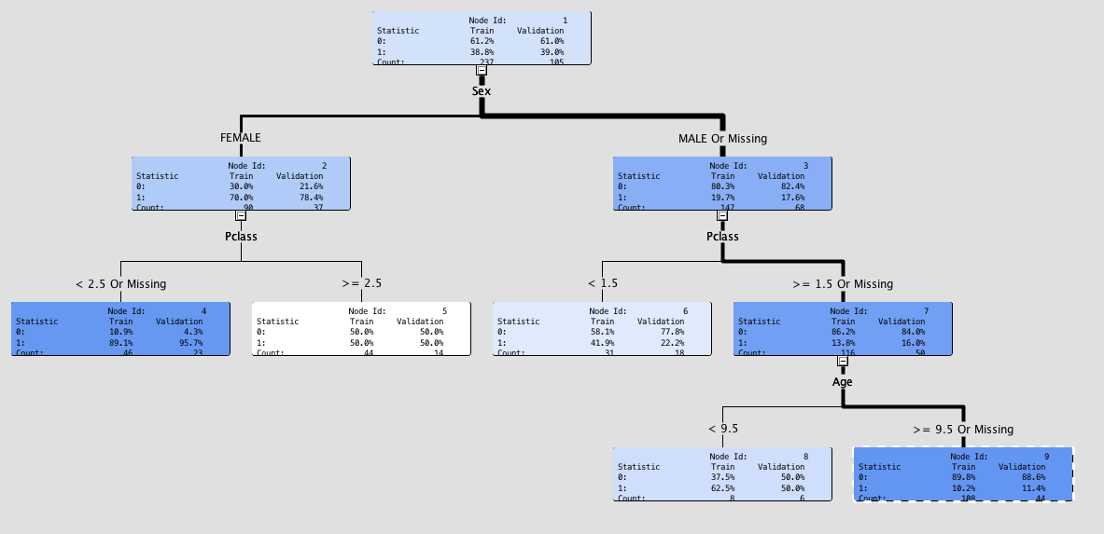
SAS Output: Decision Tree

Slide 7
Decision Trees: Intuition
Sunny
x
x
o
x
x
x
x
o
o
o
x
x
x
o
o
o
x
x
x
Wind
o
Play soccer
o
x
x
o
o
o
x
x
x
x
o
o
o
o
o
x
x
Don’t play soccer
o
x
x
x
x
x
o
x
x
x
o
o
o
x
Yes
No
o
o
x
x
o
o
x
x
x
x
o
o
o
x
o
o
o
o
x
x
x
x
o
x
x
Windy

Slide 8
Decision Trees: Intuition
Sunny
x
x
o
x
x
x
x
o
o
o
x
x
x
o
o
o
o
x
x
x
Wind
o
Play soccer
o
x
x
o
o
o
x
x
x
x
o
o
o
o
o
x
x
x
x
x
x
x
Don’t play soccer
x
x
x
x
x
x
x
Yes
No
x
x
x
x
x
x
x
x
x
x
x
x
x
x
x
x
x
x
x
x
x
x
x
x
Sunny
Windy
Yes
No
o
x

Slide 9
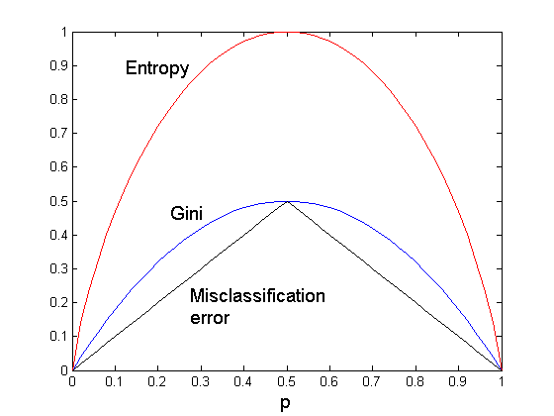
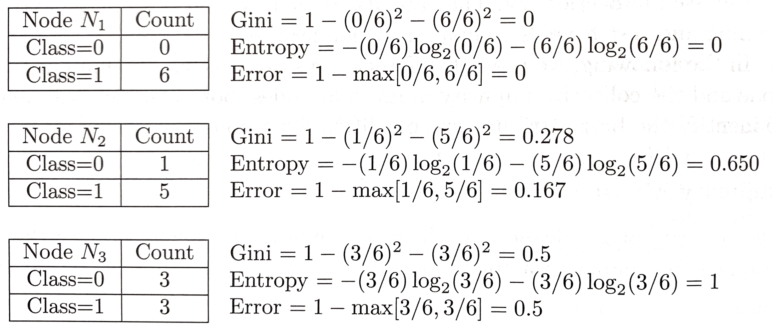
Comparison among Impurity Measures
For a 2-class problem:

Slide 10
Decision Trees: Information Gain
Information Gain is the expected reduction in entropy caused by partitioning the examples according to a given attribute.

Slide 11




Calculating Entropy and Info Gain
GPA | Work Exp. | Gmat | Admission
Ok | No | Ok | No
Ok | Yes | Ok | No
Good | No | Good | Yes
Ok | Yes | Good | Yes
Calculating Entropy of the Parent: Admission
NNYY
p_{No} = NN/NNYY = 2/4 = 0.5
p_{Yes} = YY/NNYY = 2/4 = 0.5

Slide 12
Calculating Info Gain (GPA)
GPA | Admission
Ok | No
Ok | No
Good | Yes
Ok | Yes
Information Gain:
OOGO [Map attribute to class –value of admission]
OOGO
Ok
Good
NNY
Y
What is the entropy of the Good (Y) node?
0 because all the examples on this node are the same (Y)
What is the entropy of the Ok node (children)?
p_{No} (NNY) = 2/3
p_{Yes} (NNY) = 1/3
Entropy (children) = -[2/3*log₂(2/3)+1/3*log₂(2/3)] = 0.9184
What is the info gain?
= Entropy (parent) – [weighted average]*entropy (children)
= 1 – [3/4 *(0.9184) + 1/4 * (0)] = 0.3112

Slide 13
Calculating Info Gain (Work Experience)
Information Gain:
Work Exp. | Admission
No | No
Yes | No
No | Yes
Yes | Yes
NYNY [Map attribute to class –value of admission]
NYNY
No
Yes
NY
NY
What is the entropy of the No node?
1 because prob. Is 1/2
What is the entropy of the Yes?
1 because prob. Is 1/2
What is the info gain?
= Entropy (parent) – [weighted average]*entropy (children)
= 1 – [1/2 *(1) + 1/2 * (1)] = 1 – 1 = 0

Slide 14
Calculating Info Gain (Gmat)
Gmat | Admission
Ok | No
Ok | No
Good | Yes
Good | Yes
Information Gain:
OOGG [Map attribute to class –value of admission]
OOGG
Ok
Good
?
?
What is the entropy of the No node?
What is the entropy of the Yes?
What is the info gain?
= Entropy (parent) – [weighted average]*entropy (children)
= 1 – [(?/?)*? + (?/?)*?]

Slide 15
Example of a Decision Tree
categorical
categorical
continuous
class
Splitting Attributes
Home Owner
Yes
No
NO
MarSt
Single, Divorced
Married
Income
NO
< 80K
> 80K
NO
YES
Model: Decision Tree
Training Data

Slide 16
Rule Extraction from a Decision Tree
Rules are easier to understand than large trees
One rule is created for each path from the root to a leaf
Rules are mutually exclusive and exhaustive
Home Owner
Yes
No
NO
MarSt
Single, Divorced
Married
Income
NO
< 80K
> 80K
NO
YES
Example: Rule extraction from our defaulted borrower tree
IF HomeOwner = yes THEN defaulted_borrower = no
IF HomeOwner = no AND MarSt = Single AND INCOME > 80k THEN defaulted_borrower = yes
IF HomeOwner = no AND MarSt = Divorced AND INCOME > 80k THEN defaulted_borrower = yes

Slide 17
Apply Model to Test Data
Training Data
Unseen Data
Mr. Smith applied for a loan.
Home Owner
Yes
No
NO
MarSt
Single, Divorced
Married
Should we approve it?
Income
NO
< 80K
> 80K
NO
YES

Slide 18
Classification Errors
Training errors (apparent errors)
Errors committed on the training set
Test errors
Errors committed on the test set
Generalization errors
Expected error of a model over random selection of records from same distribution

Slide 19
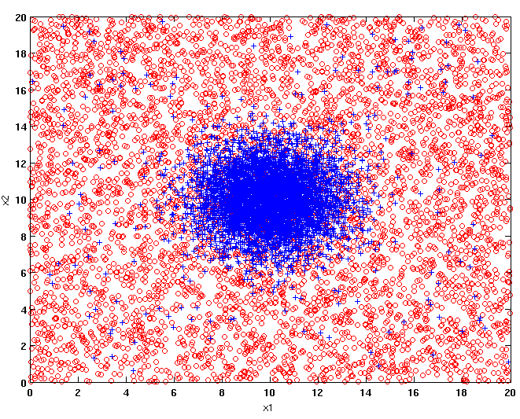
Example Data Set
Two class problem:
+ : 5200 instances
5000 instances generated from a Gaussian centered at (10,10)
200 noisy instances added
o : 5200 instances
Generated from a uniform distribution
10 % of the data used for training and 90% of the data used for testing

Slide 20
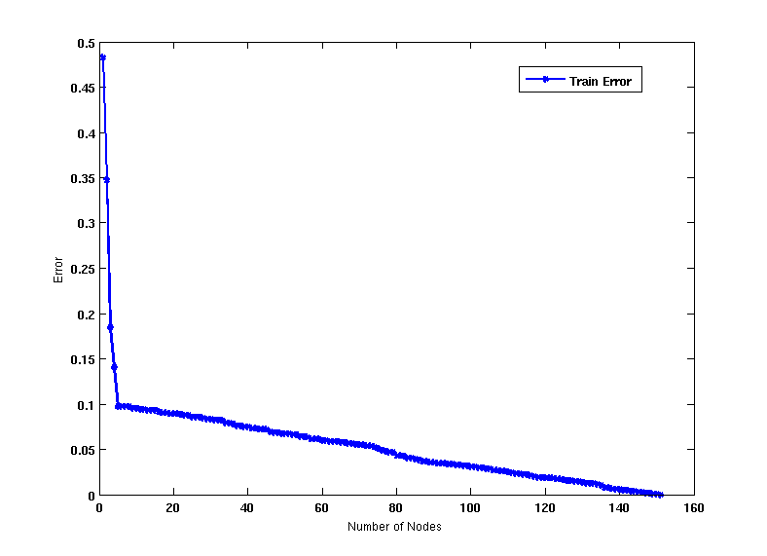
Increasing number of nodes in Decision Trees

Slide 21
Decision Tree with 4 nodes
Decision Tree
Decision boundaries on Training data

Slide 22
Decision Tree with 50 nodes
Decision Tree
Decision Tree
Decision boundaries on Training data

Slide 23
Which tree is better?
Decision Tree with 4 nodes
Which tree is better ?
Decision Tree with 50 nodes

Slide 24
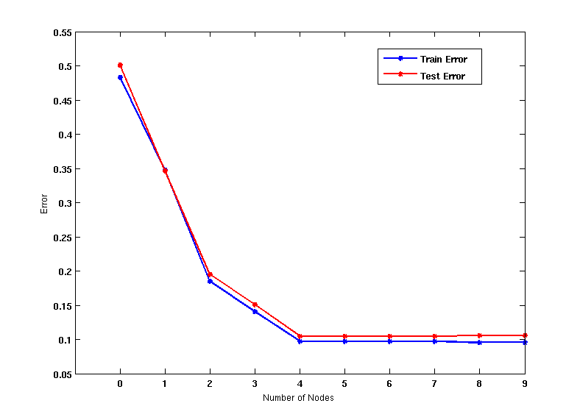
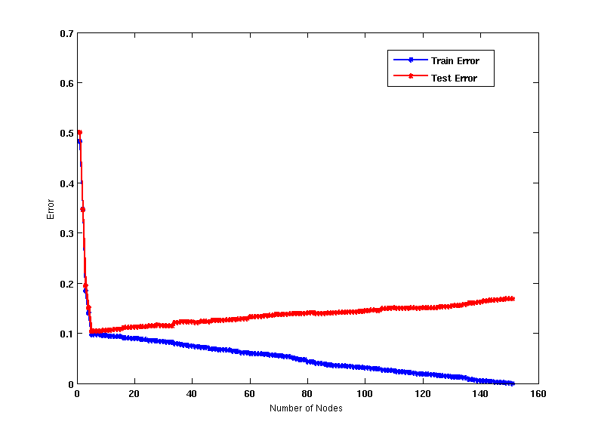
Model Overfitting
Underfitting: when model is too simple, both training and test errors are large
Overfitting: when model is too complex, training error is small but test error is large

Slide 25
Notes on Overfitting
Overfitting results in decision trees that are more complex than necessary
Training error does not provide a good estimate of how well the tree will perform on previously unseen records
Need ways for estimating generalization errors

Slide 26
Occam’s Razor (Parsimony)
Rationale: Given two models of similar generalization errors, one should prefer the simpler model over the more complex model
A complex model has a greater chance of being fitted accidentally by errors in data
Therefore, one should include model complexity when evaluating a model

Slide 27
Model Evaluation
Purpose:
To estimate performance of classifier on previously unseen data (test set)
Holdout
Reserve k% for training and (100-k)% for testing
Random subsampling: repeated holdout
Cross validation
Partition data into k disjoint subsets
k-fold: train on k-1 partitions, test on the remaining one
Leave-one-out: k=n

Slide 28
Model evaluation 1: Holdout method
Divide training data into two parts:
Training set:
use for model building
Validation set:
use for estimating generalization error
Note: validation set is not the same as test set
Drawback:
Less data available for training

Slide 29
Model evaluation 2: k-fold cross-validation
3-fold cross-validation

Slide 30
Issues Affecting Model Selection
Accuracy
classifier accuracy: predicting class label
Speed
time to construct the model (training time)
time to use the model (classification/prediction time)
Robustness: handling noise and missing values
Scalability: efficiency in disk-resident databases
Interpretability
understanding and insight provided by the model
30
Notes:
30

Slide 31
Comparing Attribute Selection Measures
The three measures, in general, return good results but
Information gain:
biased towards multivalued attributes
Gain ratio:
tends to prefer unbalanced splits in which one partition is much smaller than the others
Gini index:
biased to multivalued attributes
has difficulty when # of classes is large
tends to favor tests that result in equal-sized partitions and purity in both partitions

Slide 32
Overfitting and Tree Pruning
Overfitting: An induced tree may overfit the training data
Too many branches, some may reflect anomalies due to noise or outliers
Poor accuracy for unseen samples
Two approaches to avoid overfitting
Prepruning: Halt tree construction early ̵ do not split a node if this would result in the goodness measure falling below a threshold
Difficult to choose an appropriate threshold
Postpruning: Remove branches from a “fully grown” tree—get a sequence of progressively pruned trees
Use a set of data different from the training data to decide which is the “best pruned tree”

Slide 33
Summary: Logistic Regression
Logistic regression is similar to linear regression, except that it is used with a categorical response
It can be used for explanatory tasks (=profiling) or predictive tasks (=classification)
The predictors are related to the response Y via a nonlinear function called the logit
As in linear regression, reducing predictors can be done via variable selection
Logistic regression can be generalized to more than two classes
Notes:
33

Slide 34
Logistic Regression
Extends idea of linear regression to situation where outcome variable is categorical
Widely used, particularly where a structured model is useful to explain (=profiling) or to predict
We focus on binary classification
i.e. Y=0 or Y=1
Notes:
34

Slide 35
Python Functionality Needed
import numpy as np
import pandas as pd
from sklearn.linear_model import LogisticRegression,
LogisticRegressionCV
from sklearn.model_selection import train_test_split
import matplotlib.pylab as plt
import seaborn as sns
from dmba import classificationSummary, gainsChart,
liftChart
from dmba.metric import AIC_score
Notes:
35

Slide 36
The Logit
Goal: Find a function of the predictor variables that relates them to a 0/1 outcome
Instead of Y as outcome variable (like in linear regression), we use a function of Y called the logit
Logit can be modeled as a linear function of the predictors
The logit can be mapped back to a probability, which, in turn, can be mapped to a class
Notes:
36

Slide 37
Step 1: Logistic Response Function
p = probability of belonging to class 1
Need to relate p to predictors with a function that guarantees 0 ≤ p ≤ 1
Standard linear function (as shown below) does not:
q = number of predictors
Notes:
37

Slide 38
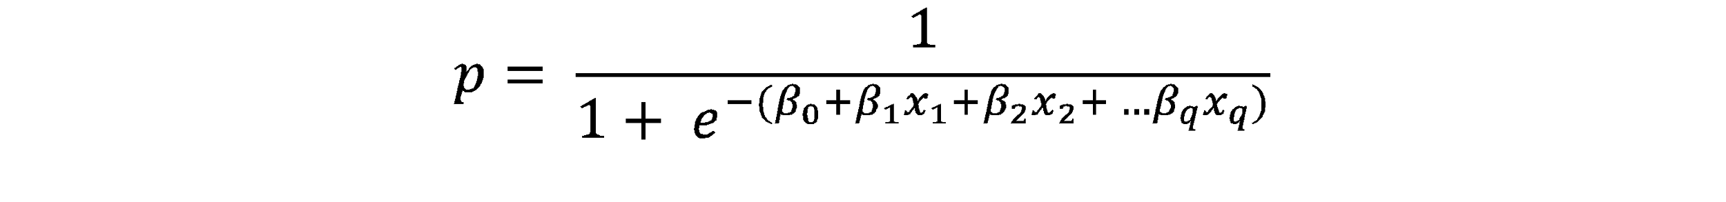
The Fix: use logistic response function
Equation 10.2 in textbook
Notes:
38

Slide 39
Personal Loan Offer (UniversalBank.csv)
Outcome variable: accept bank loan (0/1)
Predictors: Demographic info, and info about their bank relationship
Notes:
39

Slide 40

Single Predictor Model
Modeling loan acceptance on income (x)
Fitted coefficients (more later): b₀ = -6.3525, b₁ = -0.0392
Notes:
40

Slide 41
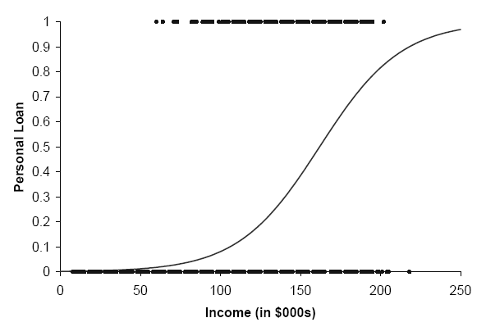
Seeing the Relationship

Slide 42
Last step - classify
Model produces an estimated probability of being a “1”
Convert to a classification by establishing cutoff level
If estimated prob. > cutoff, classify as “1”
© Galit Shmueli and Peter Bruce 2017
Notes:
42

Slide 43
Ways to Determine Cutoff
0.50 is popular initial choice
Additional considerations (see Chapter 5)
Maximize classification accuracy
Maximize sensitivity (subject to min. level of specificity)
Minimize false positives (subject to max. false negative rate)
Minimize expected cost of misclassification (need to specify costs)
Notes:
43

Slide 44
Let’s include all 12 predictors in the model now
Data Prep
bank_df = pd.read_csv('UniversalBank.csv')
bank_df.drop(columns=['ID', 'ZIP Code'], inplace=True)
bank_df.columns = [c.replace(' ', '_') for c in bank_df.columns]
# Treat education as categorical, convert to dummy variables
bank_df['Education'] = bank_df['Education'].astype('category')
new_categories = {1: 'Undergrad', 2: 'Graduate', 3:
'Advanced/Professional'}
bank_df.Education.cat.rename_categories(new_categories, inplace=True)
bank_df = pd.get_dummies(bank_df, prefix_sep='_', drop_first=True)
y = bank_df['Personal_Loan']
X = bank_df.drop(columns=['Personal_Loan'])

Slide 45
Fitting Model
# partition data
train_X, valid_X, train_y, valid_y = train_test_split(X, y,
test_size=0.4, random_state=1)
# fit a logistic regression (set penalty=l2 and C=1e42 to avoid
# regularization)
logit_reg = LogisticRegression(penalty="l2", C=1e42,
solver='liblinear')
logit_reg.fit(train_X, train_y)
print('intercept ', logit_reg.intercept_[0])
print(pd.DataFrame({'coeff': logit_reg.coef_[0]},
index=X.columns).transpose())
print('AIC', AIC_score(valid_y, logit_reg.predict(valid_X), df =
len(train_X.columns) + 1))

Slide 46
Results
intercept -12.61895521314035
Age Experience Income Family CCAvg Mortgage
coeff -0.032549 0.03416 0.058824 0.614095 0.240534 0.001012
Securities_Account CD_Account Online CreditCard
coeff -1.026191 3.647933 -0.677862 -0.95598
Education_Graduate Education_Advanced/Professional
coeff 4.192204 4.341697
AIC -709.1524769205962
coefficients for logit

Slide 47
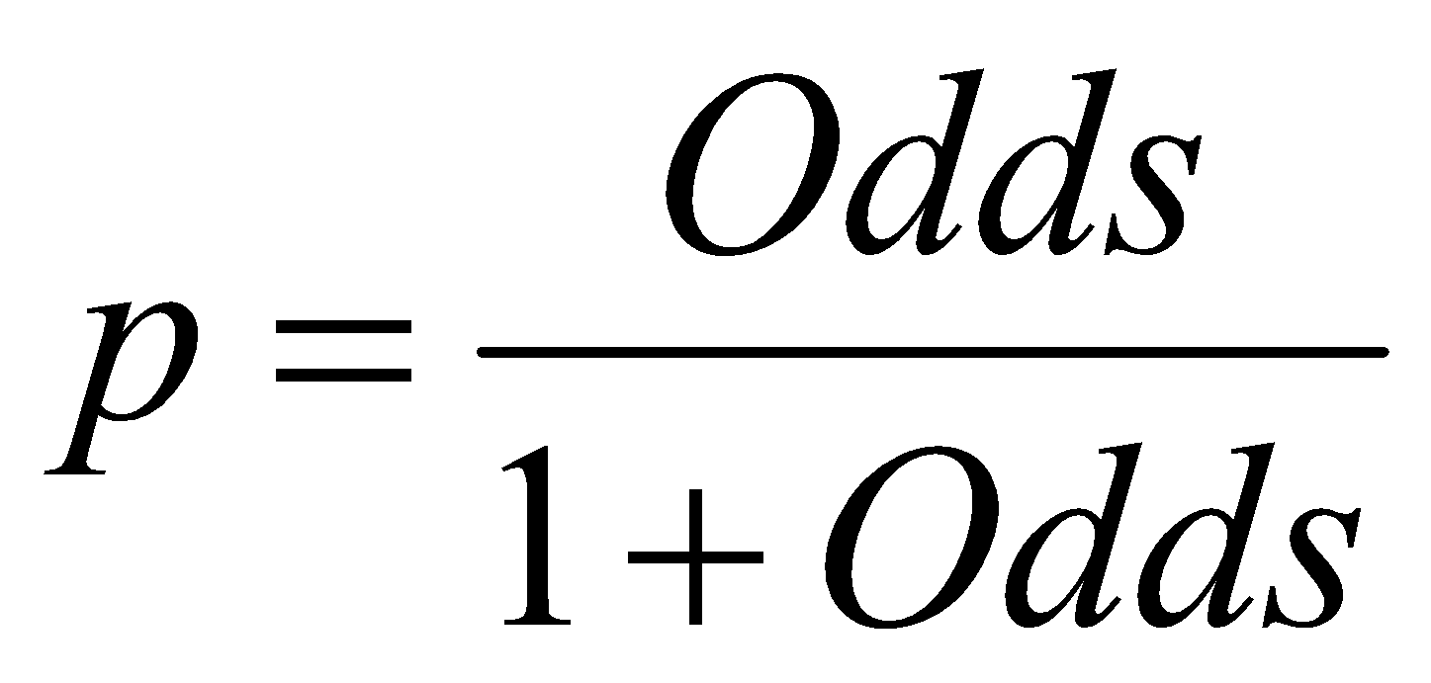
Converting to Probability
Notes:
47

Slide 48
Converting from logit to probabilities
logit_reg_pred = logit_reg.predict(valid_X)
logit_reg_proba = logit_reg.predict_proba(valid_X)
logit_result = pd.DataFrame({'actual': valid_y,
'p(0)': [p[0] for p in logit_reg_proba],
'p(1)': [p[1] for p in logit_reg_proba],
'predicted': logit_reg_pred })
# display four different cases
interestingCases = [2764, 932, 2721, 702]
print(logit_result.loc[interestingCases])
actual p(0) p(1) predicted
2764 0 0.976 0.024 0
932 0 0.335 0.665 1
2721 1 0.032 0.968 1
702 1 0.986 0.014 0

Slide 49
Interpreting Odds, Probability
For predictive classification, we typically use probability with a cutoff value
For explanatory purposes, odds have a useful interpretation:
If we increase x₁ by one unit, holding x₂, x₃ … x_{q} constant, then
b₁ is the factor by which the odds of belonging to class 1 increase
Notes:
49

Slide 50
Multicollinearity
Problem: As in linear regression, if one predictor is a linear combination of other predictor(s), model estimation will fail
Note that in such a case, we have at least one redundant predictor
Solution: Remove extreme redundancies (by dropping predictors via variable selection, or by data reduction methods such as PCA)
Notes:
50

Slide 51
Variable Selection
This is the same issue as in linear regression
The number of correlated predictors can grow when we create derived variables such as interaction terms (e.g. Income x Family), to capture more complex relationships
Problem: Overly complex models have the danger of overfitting
Solution: Reduce variables via automated selection of variable subsets (as with linear regression)
Notes:
51

